Slide 1


Big data analytics; analyzers to characterize multivariate air pollutant exposures.
Beritan Inci
Maxence Jankowiak
Wilson Martín Farfán Medina
Francisca del Pilar Cajas González

Slide 2
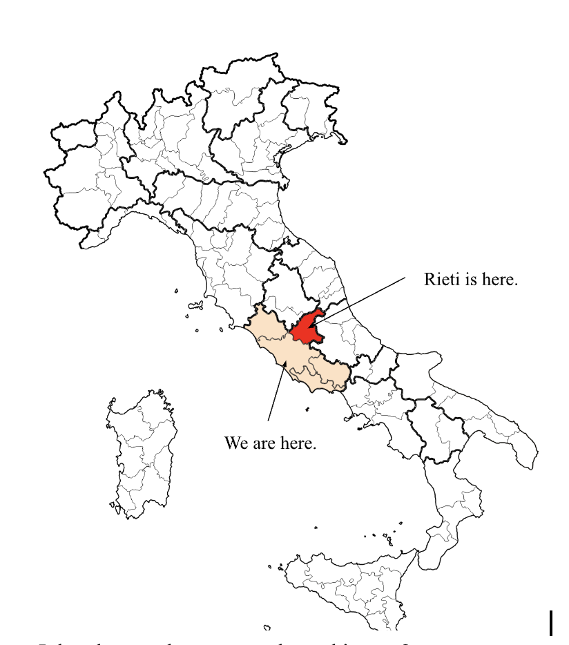
1
1
ISPRA's endeavors are predominantly centered around monitoring the condition and fluctuations of the environment, aligning with directives from the EU Commission. The data utilized in this study stem from a regional monitoring network established by the Lazio Region, particularly in Rieti, Italy.
✔️Data is being registered.
✔️Trafficated location.
✔️Close to forests.

Slide 3

VARIABLES
1
Pollulants
SO2
Sulphur dioxide
Etilbenzene
Colorless liquid organic compound
Oxylene
Is a colorless, flammable liquid
NO2
Nitrogen dioxide
O3
Ozon
CO
Carbon dioxide
Toluene
Organic solvent that belongs to the group of aromatic hydrocarbons.
PM2.5
Particulate matter (aerodynamic diameter less than 2.5).
PM10
Particulate matter (aerodynamic diameter less than 10).
13 Variables
365 Observations
daily average wind speed,
daily average temperature,
daily average pressure,
temperature excursion.
Atmospheric factors
Hidden Markov Model:
Time series such as states
State 1: Later in autumn to early spring.
State 2:Late spring to early summer.
State 3: Mid/late summer to autumn.

Slide 4
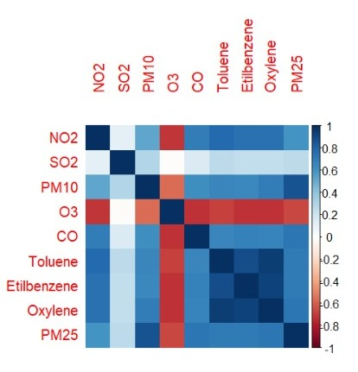

The problem: Poner gausiana anterior
Unsupervised learning
2

Slide 5
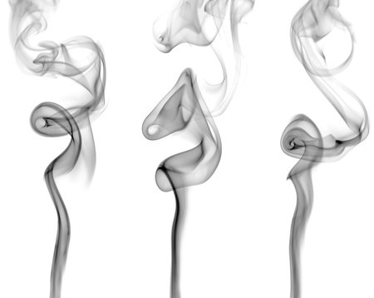
3
”…suggest choosing starting values in this way, with clusters generated by a clustering algorithm. A simple way of forming the clusters is via disjoint intervals, with the observations classified according to which of the intervals they fall into. The set of all possible partitions of the data that can be formed this way will generate a set of initial parameter estimates covering a wide range of mixing distributions. We take this as our set of starting values."
Putterman and Leroux to the rescue
(1992)
Leroux, B. G., & Puterman, M. L. (1992). Maximum-penalized-likelihood estimation for independent and Markov-dependent mixture models. Biometrics, 545-558.

Slide 6
Sensitity analysis and best model..
Cambiar texto:

Slide 7
4
Sensitivity Analysis
# Changing K clusters G <- 10mod1.mc.G <- list() mod1.mc.G.BIC <- list() for (i in 1:G) { mod1.mc.G[[i]] <- Mclust(cont, G = i) mod1.mc.G.BIC[[i]] <- mod1.mc.G[[i]]$bic } # Max. Accuracy mod1.mc.G.BIC %>% unlist() %>% max() How many K (neighbours) we need to achive itmod1.mc.G.BIC %>% unlist() %>% which.max() %>% as.numeric # this shows that the algorithm was right in the first attempt

Slide 8

5
Top 3 models based on the BIC criterion MCLUST:
VVE,6
-1814.103
VVE,5
-1858.504
VVE,8
-1877.978
McLachlan and Basford (1988) suggest choosing starting values in this way, with clusters generated by a clustering algorithm.

Slide 9
6
Hidden States gaussianas

Slide 10
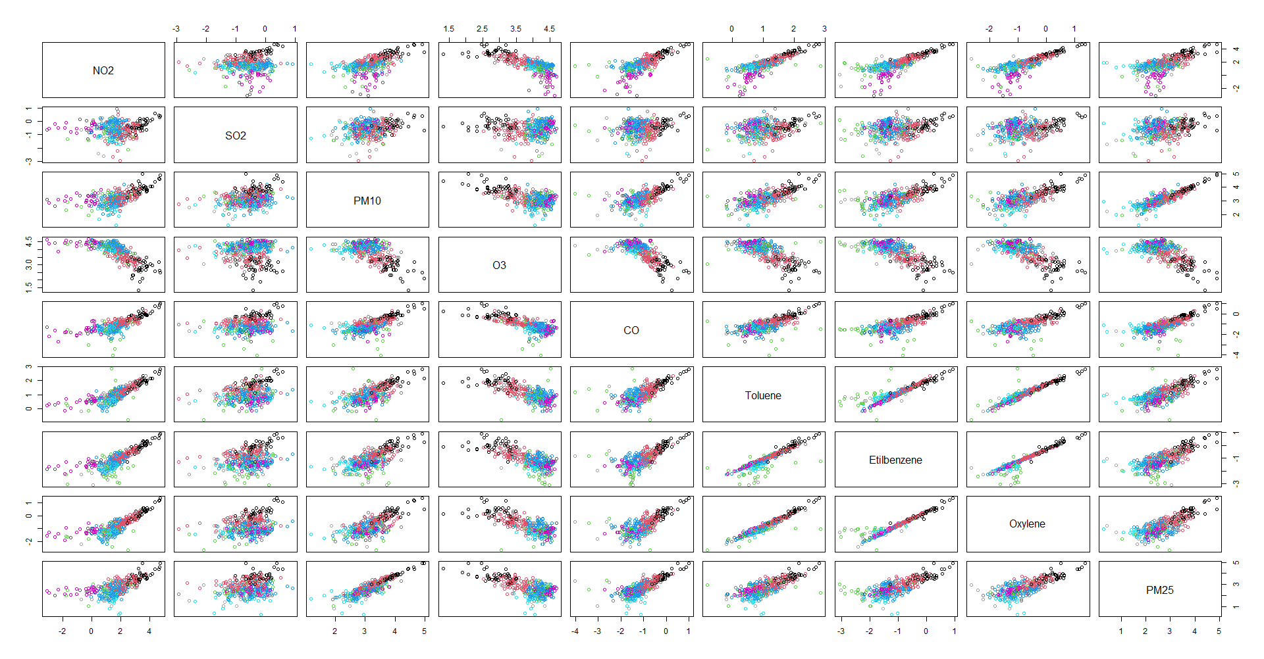
What are EXACTLY the clusters? MEANING

Slide 11
What are EXACTLY the clusters? INDIVIDUAL GRAPHS (pon 4 scatter plots
6.2

Slide 12
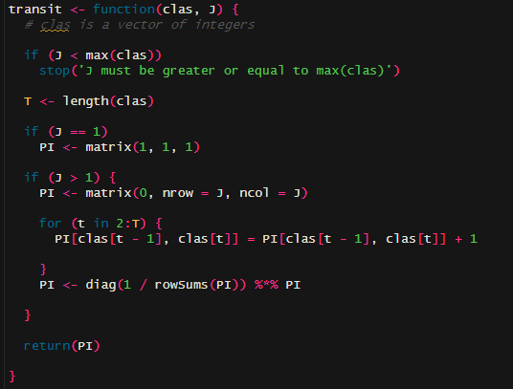
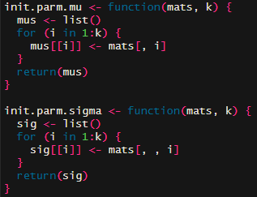
7
Some important functions

Slide 13
8
Gaussian Model and its importance fran
“Since we perform our analysis on log-transformed data, the selection of Gaussian conditional distributions for our HMM seems suitable.” (Maruotti et al., 2017)

Slide 14
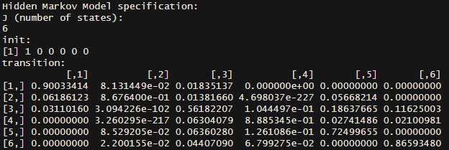
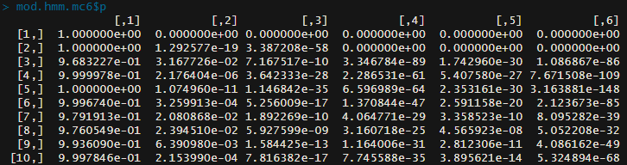
Results of the HMM

Slide 15
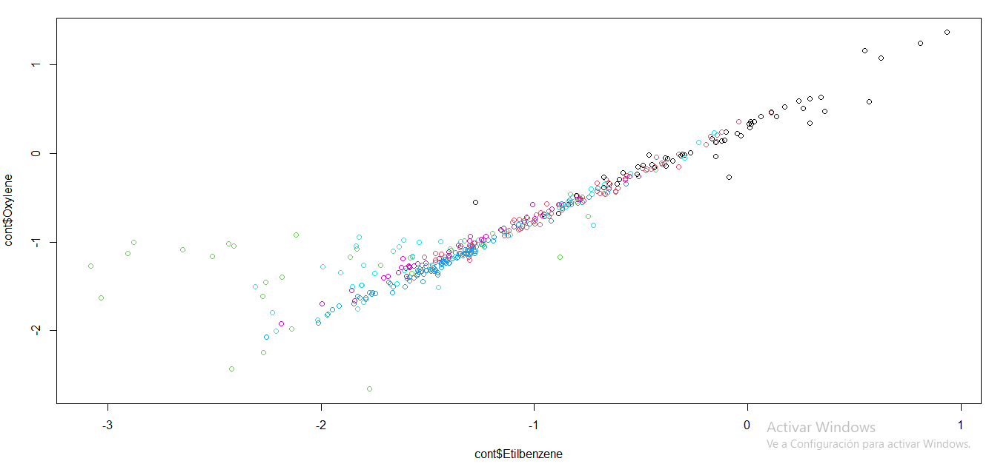
9
Clusterization is almost the same between MCLUST & HMM

Slide 16
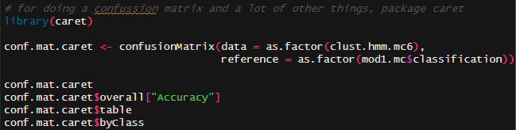
Categorization – Library(caret) to the rescue!!

Slide 17
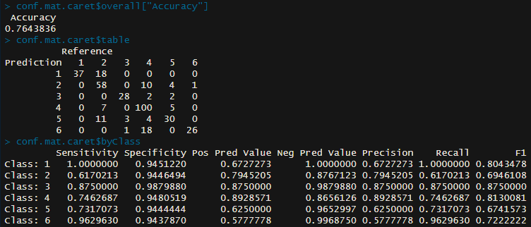
10
Let’s Check How it Categorized :D

Slide 18
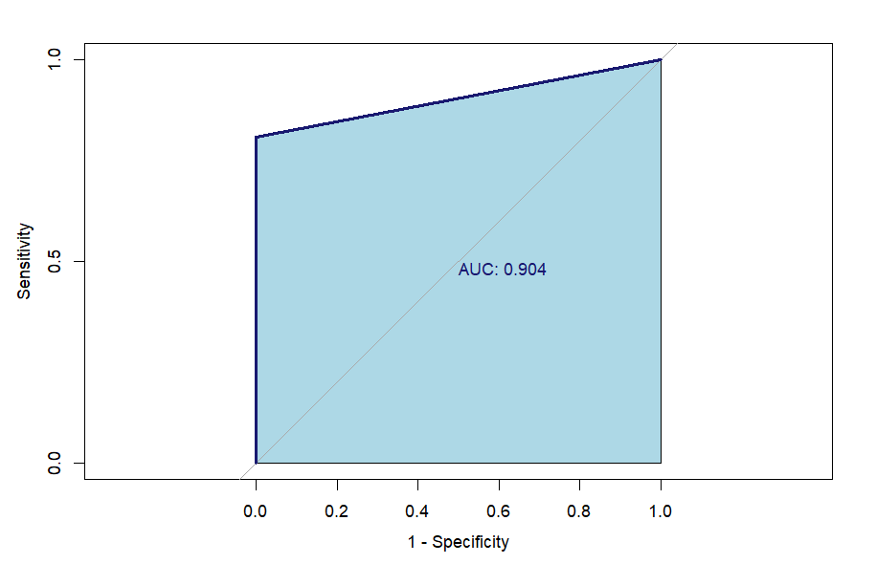
11
ROC AND BIC
Formula BIC:
Area under the curve: 0.9043
BIC:
-59.01372

Slide 19

12

Slide 20
13

Slide 21
What Happened
with Atmospheric factors?

Slide 22
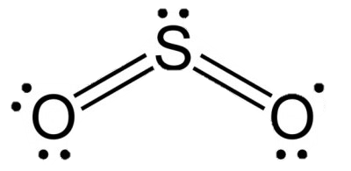
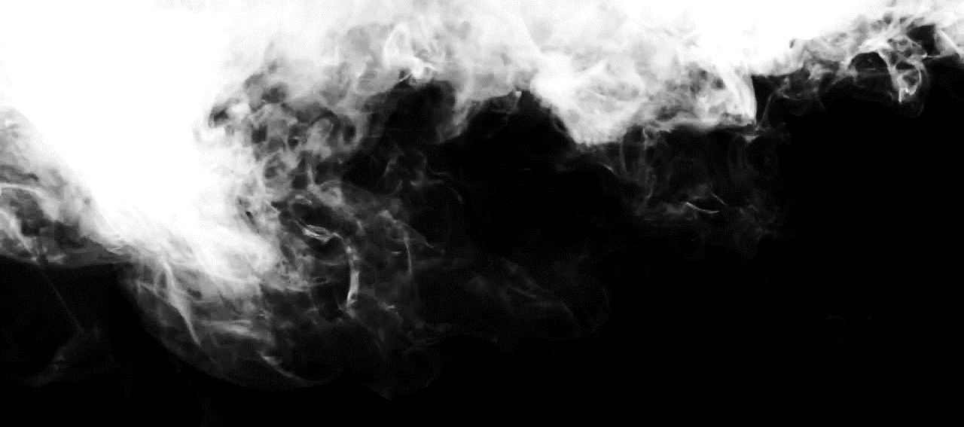
Conclusions
14
1. HMM performs better than MClust we take into account time dependence
2. There's a trade-off because accuracy in the confusion matrix goes up but the BIC value skyrockets
3. Regarding our Project, futher studied.

Slide 23
References:
Leroux, B. G., & Puterman, M. L. (1992). Maximum-penalized-likelihood estimation for independent and Markov-dependent mixture models. Biometrics, 545-558.

Slide 24
